Slide 1
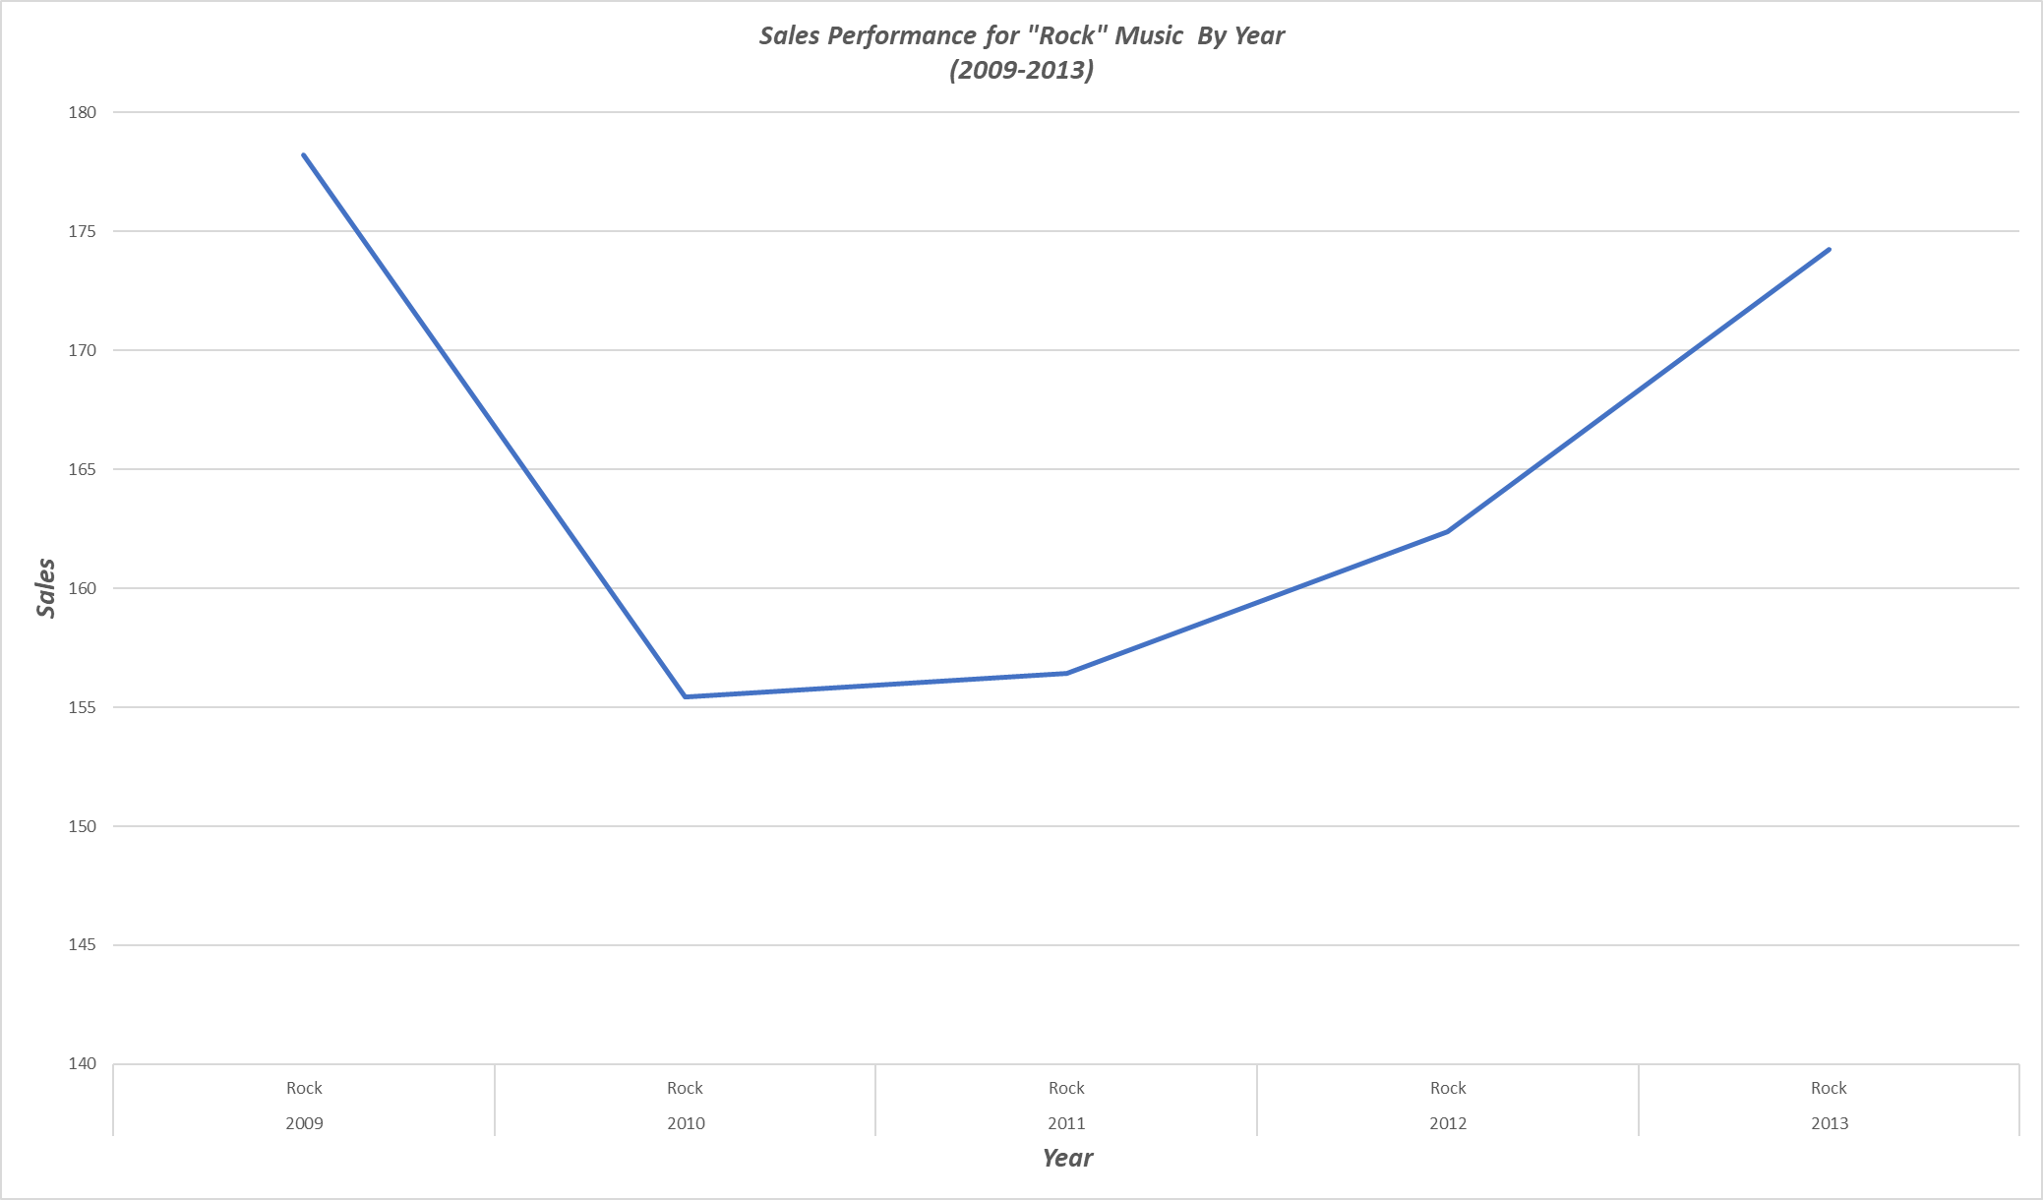
1. What is the year-over-year sales performance of the most popular genre in terms of sales?
<visualization>
“Rock” music turned out to be the most popular genre of music in terms of sales across all years (2009-2013).
Despite generating most sales, Rock music revenue fluctuated by year; it peaked in 2009 then dropped in 2010, but it has been increasing steadily ever since.

Slide 2
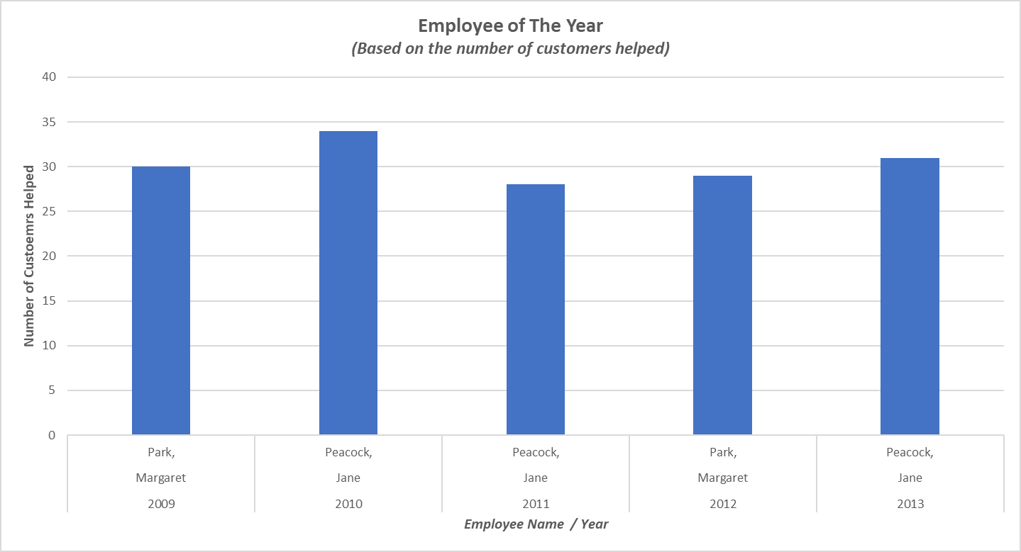
2. What is the name of the employee who helped most customers?
<visualization>
Margaret Park came first as the employee who helped most customers in two years: 2009, and 2012.
Jane Peacock came first three times in years: 2010, 2011, and 2013. Jane helped the most customers across all years in with the total of 34 customers supported in 2010.

Slide 3
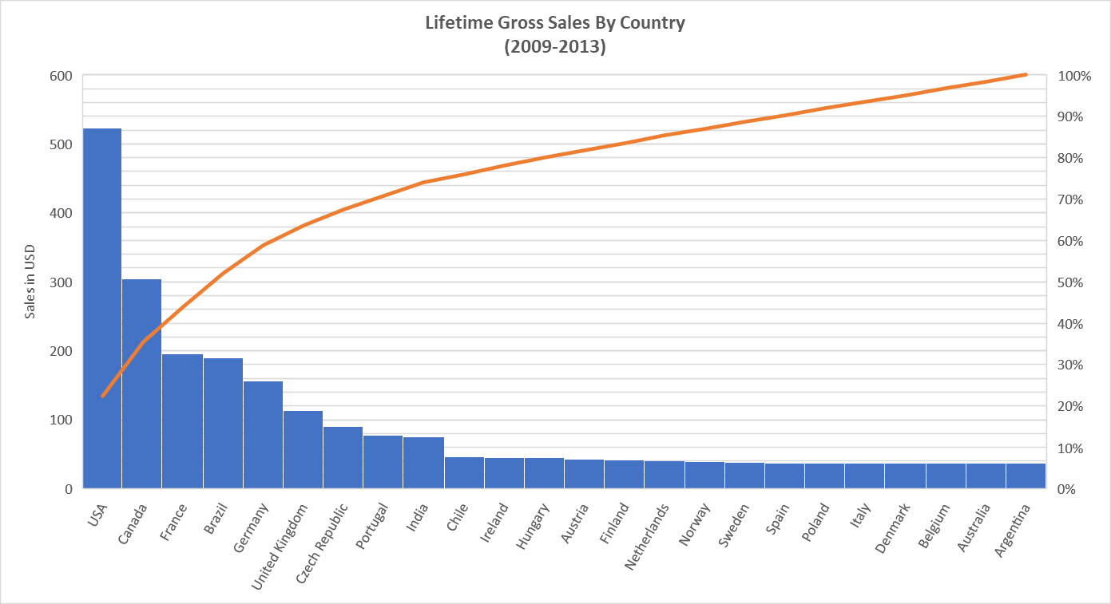
3. Which countries weigh more in terms of generating sales?
<visualization>
By investigating our dataset, it turns out that the US, Canada, and France are the most important three countries in generating sales across all years (2009-2013).
Worth mentioning that Brazil isn’t too far behind France.
On the other hand, seven countries share the last place with equal values.

Slide 4
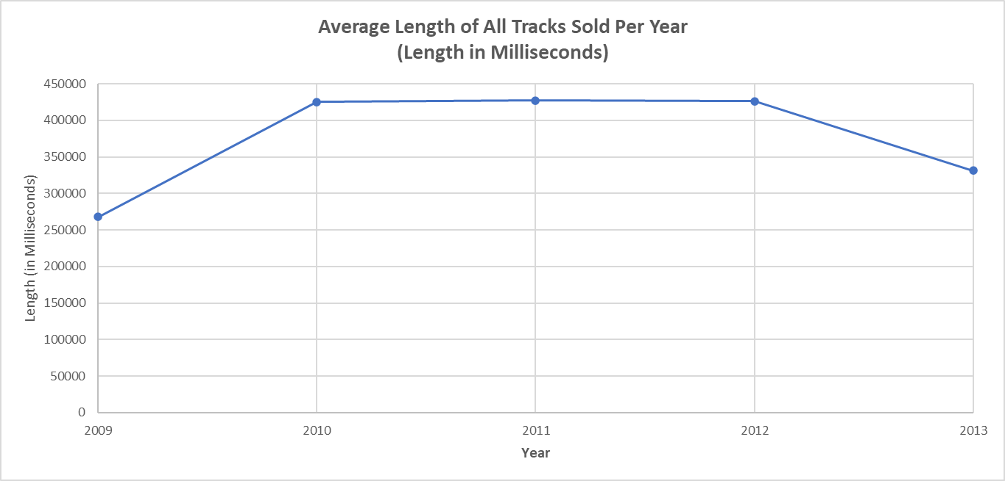
4. What is the average length of tracks sold per year? Is there a trend in the length of the tracks sold?
<visualization>
Based on the findings derived from our dataset, we can see that the average track length was the shortest in 2009 and 2013, and it was the longest in the years between, and it was steady for the years 2010, 2011, and 2012.
However, we can’t see a specific upward or downward trend in the length of tracks sold.

